Slide 1
Presentation project 1
Barbe Victor
Bregeon antoine
Gaucher Pierre louis

Slide 2
Presentation of 421 game
A classical french game that is played in cafes
We will try to find the different probabilities of event that can happen when throwing 3 dices
The different scenarios we will study are:
Do a 421, make an ase (getting 11 and another number), make a brelan (getting 3 times the same number), make a suite (getting 3 following number), make a nenette (any event which isn’t listed above)

Slide 3
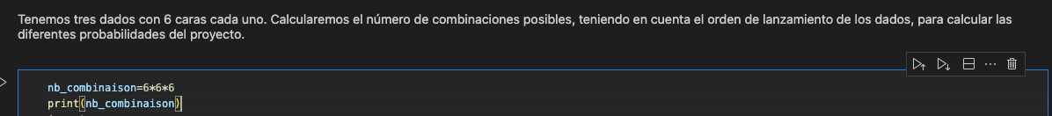
How to proceed
To compute the different probabilities, we will look for the number of event that fill the needed conditions and see how many general possibilities there are:
Since we throw 3 dices with 6 possibilites for each dice we get 216 possibilities.

Slide 4
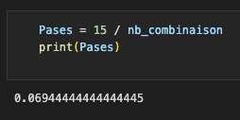
Make a ase
We have different ways of making an ase : 211,311,411,511,611
For each ase, the number can be arranged in 3 different ways
We are not taking order into account since the dices are thrown simoultanousely
This means that we have 3 possibilities for each ase, which makes 3*5 possibities for a random ase.
We divide the total number of combinaison to get the probability

Slide 5
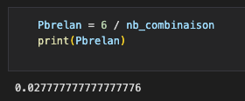
Make a brelan
We have 6 different brelans that exist: 666,555,444,333,222,111
For each brelan the numbers can only be sorted in a way
We are not taking order into account since the dices are thrown simoultanousely, but here it doesn’t change the final outcome
This means that we have 1 possibilities for each brelan, which makes 1*5 possibities for a random brelan.
We divide the total number of combinaison to get the probability

Slide 6
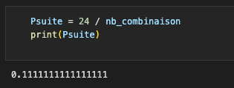
Make a suite
We have 4 different suites that exist
For each suite number can be sorted in 6 ways
We are not taking order into account since the dices are thrown simoultanousely
This means that we have 3 possibilities for each suite, which makes 3*6 possibities for a random suite.
We divide the total number of combinaison to get the probability

Slide 7
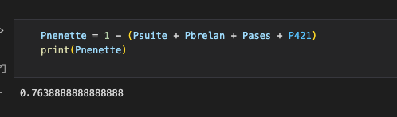
Make a nenette
Since the nenette consitutes the rest of the univers of possible outcomes, we can compute the probability

Slide 8
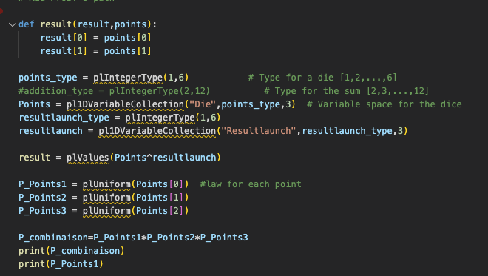
Using probt

